Slide 1
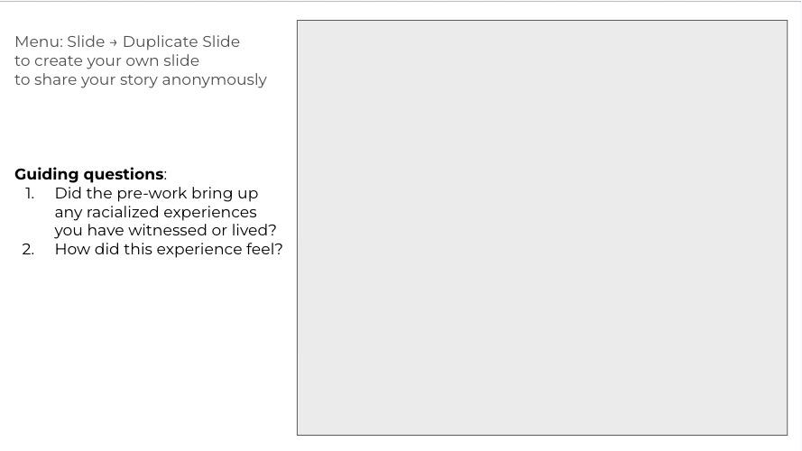
Share your experience here:

Slide 2
Share your experience here:

Slide 3
Share your experience here:

Slide 4
Share your experience here:

Slide 5
Share your experience here:

Slide 6
Share your experience here:

